Slide 1
Shifts in Supply and Demand
Scenarios from Fever 1793.

Slide 2
Determinants of Demand
Consumer tastes/preferences
Consumer income/wealth
Prices of related goods
Consumer expectations of the future
The number of buyers

Slide 3
Determinants of Supply
Productivity/Technology
Prices of resources used
Government policies
Producer expectations about the future
The number of sellers

Slide 4
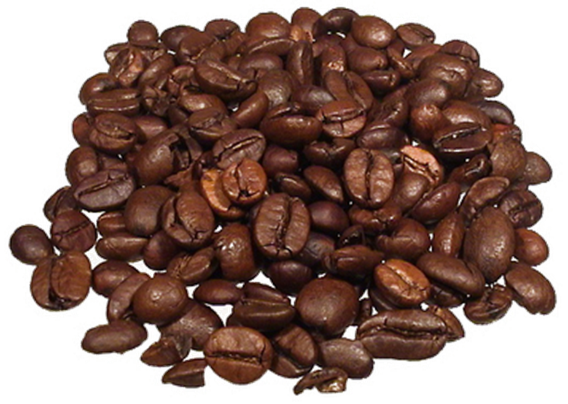
Market: Coffee
Philadelphia doctors decide that coffee prevents people from contracting yellow fever.

Slide 5
Market: Coffee
S₁
Price
P₂
P₁
D₂
D₁
Q₁
Q₂
Quantity

Slide 6

Market: Coffee
Two new coffee houses open on the same street as Mattie’s coffee house.

Slide 7
Market: Coffee
S₁
Price
S₂
P₁
P₂
D₁
Q₁
Q₂
Quantity

Slide 8

Market: Coffee
Cook Coffeehouse announces that it will cut coffee prices in half starting next week.

Slide 9
Market: Coffee
S₁
Price
P₁
P₂
D₂
D₁
Q₂
Q₁
Quantity

Slide 10

Market: Vegetables
Yellow fever breaks out in Philadelphia. Farmers refuse to bring produce to market for fear of contracting the disease.

Slide 11
Market: Vegetables
S₂
S₁
Price
P₂
P₁
D₁
Q₂
Q₁
Quantity

Slide 12
Determinants of Demand
Determinants of Supply
Consumer tastes/ preferences
Consumer income/wealth
Prices of related goods
Consumer expectations of the future
The number of buyers
Productivity/Technology
Prices of resources used
Government policies
Producer expectations about the future
The number of sellers

